Slide 1
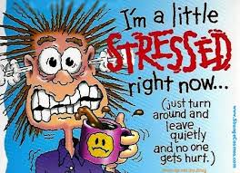
Eat Your Stress Away
By: Jahnavi Arora, Shimona Agarwal, & Kinjal Sharma

Slide 2
What Is Stress
Definition: a state of mental or emotional strain or tension resulting from adverse or very demanding circumstances
In Simple Words: Stress is the feeling one gets when he/ she is placed in a challenging or tough situation
But every person has their own definition of stress.
Teenagers might be stressed because of:
Tests & Homework
College
Adults might be stressed because of:
Jobs
Bills
Their Children

Slide 3
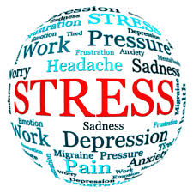
Largest Causes of Stress

Slide 4
Is All Stress Bad?
Positive
Negative
Helps a person perform better under pressure
Keeps you alert and aware
Creates Fight or Flight Response which is especially important in emergencies
Motivates
Stress overload = too much stress
-when this happens the person begins to feel overwhelmed and/or depressed
-this happens because as stress hormones are continually released, the body begins to feel weaker
-immune system becomes weaker

Slide 5
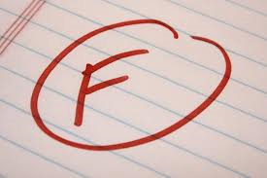
Why Should You Care
Can effect your grades
Can make you age faster
Increase in weight
Bad thoughts and aura
Laziness
Loss in Brain Cells

Slide 6
Hitbhuk, Ritbhuk, Mitbhuk
Hitbhuk – eat food that is good for the health and not according to taste
Mitbhuk – eating in proportions because access of everything is unhealthy
Ritbhuk – food that you are eating must be bought with hard earned money

Slide 7
Foods That Trigger Stress
Foods Fast Food Butter Cheese Sugar Almonds & Nuts Coconut Oil Meat | Drinks Sugary Drinks Soda Coffee Tea Lattes Alcohol Cocoa Caffeinated Drinks

Slide 8
Foods That Decrease Stress
Food Fresh Vegetables Fresh Fruits Fish Soups Yogurts Herbal Products | Drinks Water Tea Warm Milk Fruit Juice

Slide 9
When Should You Eat
1. Heavy breakfast
2. Light lunch
3. If hungry in between eat a salad, fruits, yogurts
4. Light dinner
Important to Know:
You Should Eat every 3 – 4 hours to maintain your stress levels
Never eat within 3 hours of bedtime

Slide 10

What We Hope You Take From This Presentation
What Stress is
What you should and should not eat
What causes stress
Optimal amount of Food

